Slide 1
48024 Applications Programming
Dr Angela Huo

Slide 2
Frequently Asked Questions
Why I can’t access to Lab 2?
Finish Jave Refresher Module0 and Module 2 besides Study Module
When is the deadline of the lab submission?
Different Lab has different deadline
FINAL EXAM:
You need to take the exam to pass the subject!
Consultation Time：
Friday afternoon 13:00-17:00PM (except week3, 6 and 7)
FLP (CB11.05.300)

Slide 3
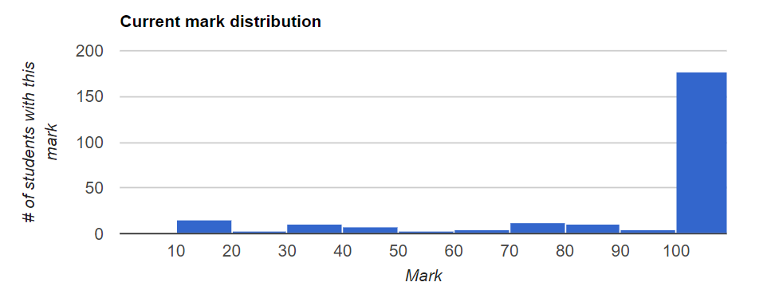
Lab 2 Review

Slide 4
Incorrect data
% java AverageDays
== Benchmark program's output == | == Your program's output ==
Average days per month = 30.416666666666668 | Average days per month = 30.4
The bug: only 10 months in array:
int months[] = {31, 28, 31, 30, 31, 31, 30, 31, 30, 31};

Slide 5
Output format
Prompt should be “Value: “
% java AverageValue
== Benchmark program's output == | == Your program's output ==
Value: 2 | Enter a positive integer2 Value: 4 | Enter a positive integer4 Value: -1 | Enter a positive integer-1 Average = 3.0 | Average 3.0
Missing =
This symbol is explained in Module 0 of the refresher course.

Slide 6
Repeated output
== Benchmark program's output == | == Your program's output ==
Character: t | Character: Character: r | t Character: e | Vowel count = 0Character: Character: e | r Character: . | Vowel count = 0Character: > e > Vowel count = 1Character: > e > Vowel count = 2Character: > . Vowel count = 2 Vowel count = 2
Question: what’s causing the output to be repeated?

Slide 7
Repeated output
public class CountVowels { public static void main(String[] args) { int count = 0; System.out.print(“Character: “); char c = In.nextChar(); while (c != '.') { if (c=='a' || c=='e' || c=='i' || c=='o' || c=='u') count++; System.out.println("Character: "); c = In.nextChar(); System.out.print("Vowel count = " + count); } Move the output after the loop } }

Slide 8
Pattern mistake #1
Read pattern
System.out.print(“<prompt>”); <type> <variable> = <read operation>;
public class AverageValue { public static void main(String[] args) { ? int value = In.nextInt(); double sum = 0.0; int count = 0; while (value != -1) { sum = sum + value; count++; } double average = sum/count; } }

Slide 9
Pattern mistake #2
Read loop pattern
<read pattern>
while (<value> != <end of input>) { <use value> <read pattern>
}
public class AverageValue { public static void main(String[] args) { System.out.print(“Value: “); int value = In.nextInt(); double sum = 0.0; int count = 0; while (value != -1) { sum = sum + value; count++; ? } double average = sum/count; } }

Slide 10
Pattern mistake #3
int sum = 0; int count = 0; System.out.print("Value: "); int num = In.nextInt(); while (num != -1) { if (num > 0) {{ sum++; count++; } System.out.print("Value: "); num = In.nextInt(); } double average = (double) sum/count; System.out.println("Average value = "+average);
Sum pattern
<type> sum = 0;
<for each value> sum += <value>;

Slide 11
Lab 3
From this week, lab monitor will check your patterns books. Have them ready! ------It will get harder as the weeks go by to keep all of the patterns
This week is all about breaking away from patterns and thinking up new solutions.
You will make the job easier for yourselves by breaking down the goal into incremental goals.
Most important: You will learn how to debug!!!

Slide 12
Timing
25min Intro + Demo
3-5min Form a group, discuss about the task
30-60 minutes -- Groupwork
Remaining time -- Coding
See you next week!

Slide 13
Contact
Subject Coordinator and Lecturer: Angela Huo
Email: huan.huo@uts.edu.au
Contact information on UTSOnline

